Slide 1
Bobbleheads and Dodger Dogs
Miller 2015

Slide 2
Dodger Stadium
Dodger Stadium, with a capacity of 56,000, is the largest ballpark in the world.
Dodger Stadium was filled to capacity only twice in 2012.
There were two cap promotions and three shirt promotions in 2012.
Fireworks were used thirteen times on Friday nights, and once on the Fourth of July.
eleven bobblehead promotions occurred on night games, six of those being Tuesday nights.

Slide 3
Graphics – Box Plots
Exploratory graphics help us find models that might work for predicting attendance and evaluating the effect of promotions on attendance.
Dodgers Attendance by Day of Week – Box Plot
Dodgers Attendance by Month – Box Plot

Slide 4
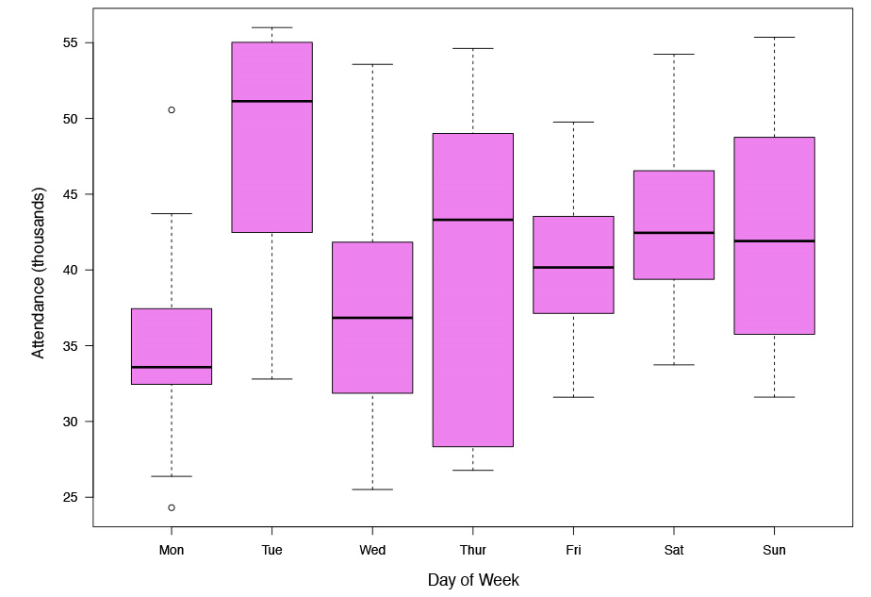
Dodgers Attendance by Day of WEek

Slide 5
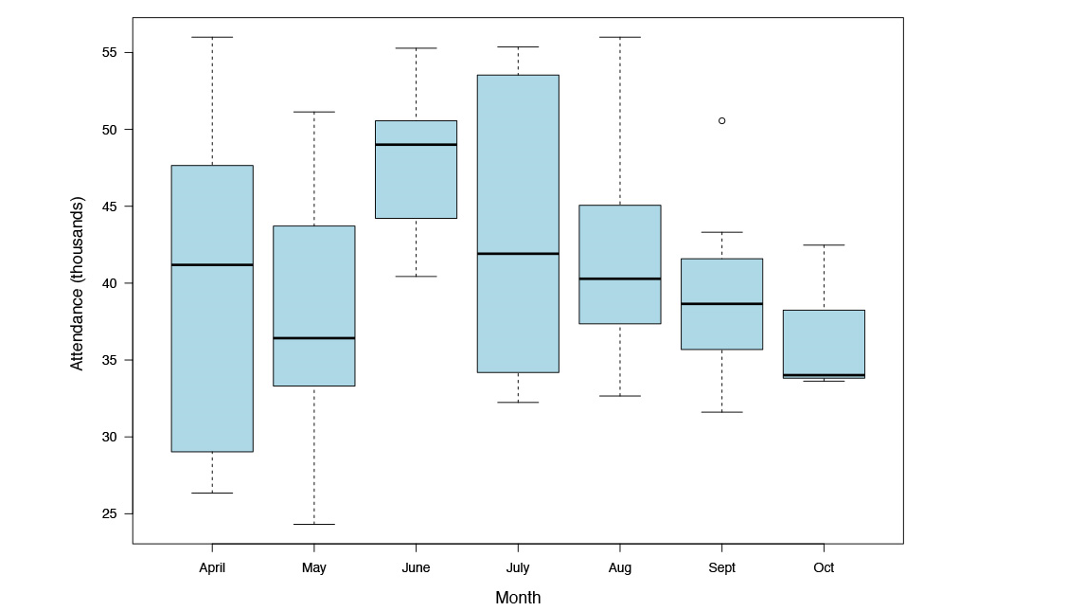
Dodgers attendance by Month

Slide 6
Graphics – Scatter Plots
More advanced graphics can speak to more relationships:
Scatter Plots of Temperature and attendance
Controlling for
Time of game (day or night)
Weather (clear or cloudy skies)
Fireworks (yes or no)

Slide 7
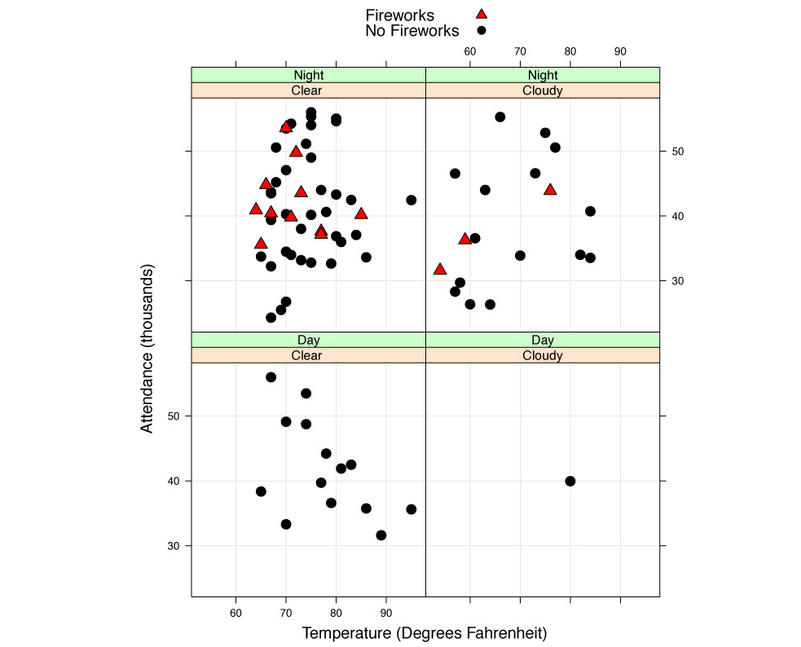
Dodgers Weather, Fireworks, and Attendance

Slide 8
Graphics – Strip Plots
Strip plots of attendance by opponent or visiting team
Controlling for Day or Night

Slide 9
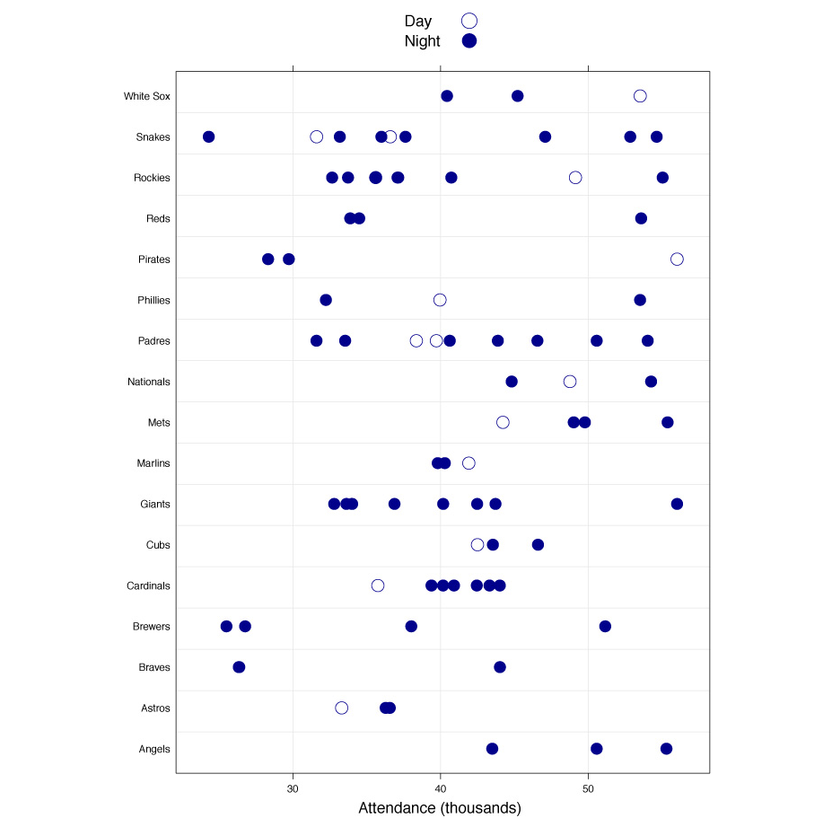
Dodgers Attendance by Visiting Team

Slide 10
Attendance Prediction
Linear Regression of Attendance on Month, Day of Week, and Bobblehead
Use a Training and Test Mechanism
Produce a Scatter Plot of Predicted versus Actual, by Train and Test, with Bobbleheads identified by points
Run Whole Data Set in Regression

Slide 11
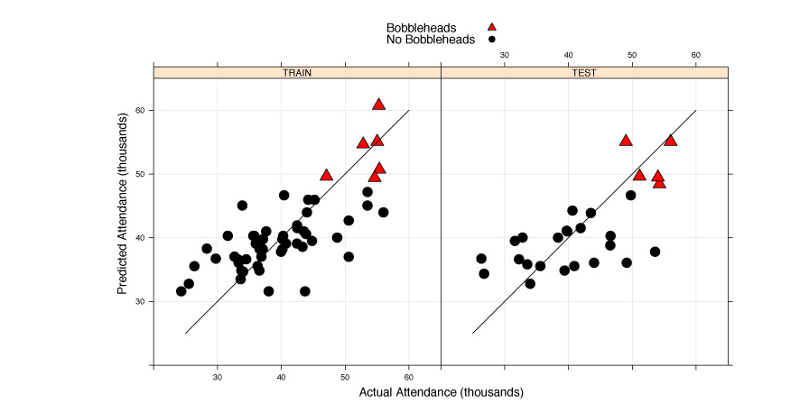
Regression Model Performance: Bobbleheads and Attendance

Slide 12
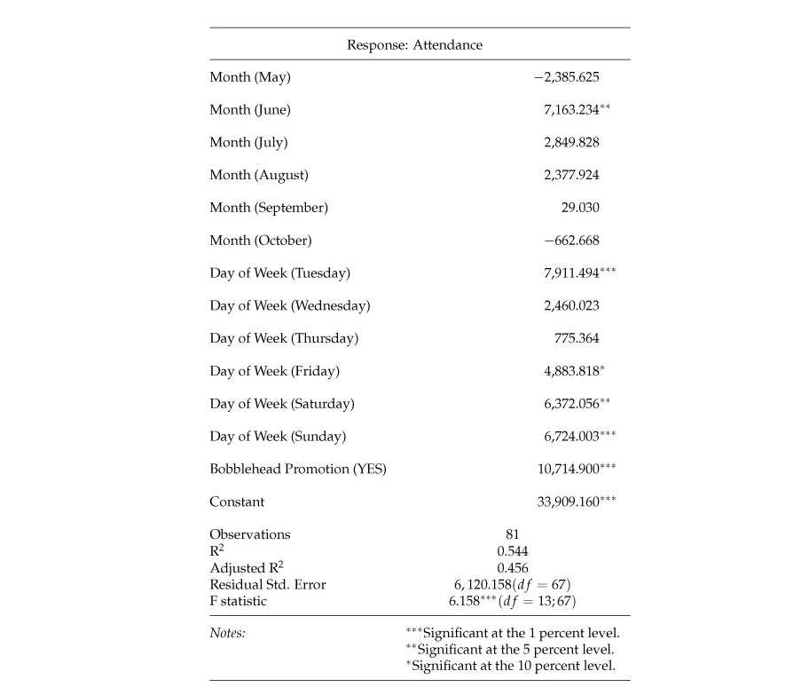
Regression of Attendance on Month, Day of Week, and Bobblehead Promotion

